Slide 1
Writing A Vision for Your Marriage!
Larry & Lorrie Russell
Our heart is that Yeshua will meet you in a tremendous way and bring joy and vibrancy into your relationship!

Slide 2
“Writing Your Vision”

Slide 3
Preparation for a Vision Statement might include questions such as these:

Slide 5
Determine what categories you want to include in your Vision
God/Faith
Husband-Wife Relationship
Parenting/size of family
In-laws, Grown Children and Grandchildren
Ministry and Serving
Communication
Work
Lifestyle
Leisure Activities
Romance & Sex
Finances

Slide 6
Tools to enable you to implement your vision statement in real life.
Forgiveness Process
A Process for Learning to Trust
Recognizing what your spouse’s Love Language is and how your spouse hears Love
Navigating the awkward waters of romance, intimacy, & sexuality
How you make financial decisions
How to create a Safe Place to talk about difficult issues

Slide 7
Safety
Feeling free to open up and reveal who you really are and know that your spouse will still love, understand, accept, and value you without fearing that you will be judged, criticized, or devalued.

Slide 8
Do you feel emotionally safe in your relationship?
Is your spouse a safe person?

Slide 9
When we feel emotionally safe, we open our hearts and become connected . . . creating intimacy.
When we feel emotionally unsafe, we close our hearts and become disconnected . . . creating a lack of emotional intimacy.

Slide 10
What is the State of your Heart?
Open
Gentle, kind, tender
Sensitive, caring, compassionate
Connected
Interested, focused, attentive
Unselfish
Transparent
Closed
Harsh, mean,
cruel
Insensitive -
uncaring
Distant -
Unavailable
Apathetic or lack of interest
Numb, lifeless

Slide 11
Study of 1,000 Couples
Unsafe
Criticism
Withdrawal
Belittled
Sarcasm
Judged
Ignored
Attacked
Controlled
Gossip
Not listened to – try to fix me

Slide 12
Study of 1,000 Couples
Unsafe
Criticism
Withdrawal
Belittled
Sarcasm
Judged
Ignored
Attacked
Controlled
Gossip
Not listened to – try to fix me
Safe
Express gratitude
Don’t judge my feelings & thoughts
Love & Accept me unconditionally
Practice healthy communication
Share your feelings & thoughts
Listen – show genuine interest in what I share – don’t try to fix me

Slide 13
I feel emotionally safe when you . . .
Listen to me without being defensive
Are warm and connected to me
Can hear me without judging me
You can listen without being critical
Are willing to not talk about our issues on a date night
How would it feel for you to finish this sentence?

Slide 14
NOW you are ready to begin the Process of writing a Mission Statement for your Marriage

Slide 15
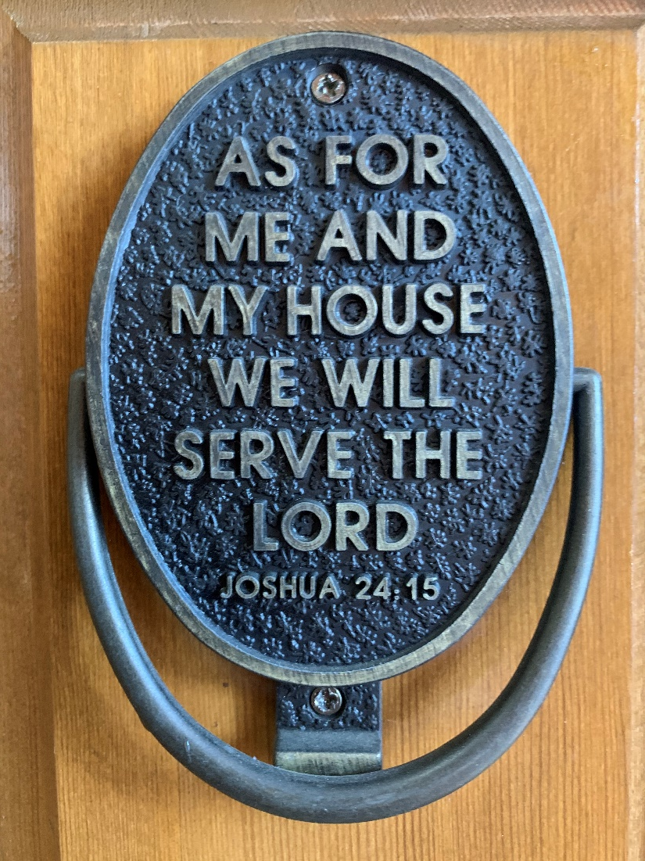
Biblical Vision Statements

Slide 16
Biblical Vision Statements
Unless the LORD builds the house, the builders labor in vain.
Psalm 127:1
. . . A married man has to think about his earthly responsibilities and how to please his wife . . . . . . A married woman has to think about her earthly responsibilities and how to please her husband.
I Cor. 7:33-34

Slide 17
Begin by developing a good set of questions, and answering them individually
Set up a time to discuss them with your spouse and pray together before you begin
Each of you take time to read your lists
Begin by marking the ones where you agree and have the same or similar answers. Make a list.
Keep it simple – doesn’t have to be difficult
Process of vision construction

Slide 18
Spend Time Making Changes and Praying over your Vision
When you’re committed to it, post it in a prominent place in your home and ask God to help you live it every day!
Read it together daily for 2-3 weeks
Evaluate it monthly for the first year to see if you are following through or if you need to change something.

Slide 19
Larry & Lorrie Russell Vision Statement
We place God at the center of our home!
We live according to God’s priorities.
We love each other out of our needs list.
We respect & trust each other.
We devote ourselves to God’s will for our lives.
We do our best to stay physically & emotionally healthy.
We make travel a high priority.
We strive to make each other’s dreams & goals come true.
We foster an environment where we both can continue to grow in various areas of our lives.
We live debt free except for our home.
Our home provides a safe, warm, peaceful, and inviting atmosphere for our family and others.
As for me and my house we will serve the Lord
Joshua 24:15

Slide 20
Can two people walk
together without agreeing
on the direction?
Amos 3:3 NLT

Slide 21
Now it is time for you to practice!

